Slide 1
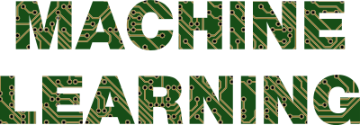

Slide 2
1) What is Machine learning ?
Machine Learning is an application of artificial intelligence (AI) where a
computer /machine learns from the past experiences input data makes future
Predictions.
2) Give two application of the machine learning algorithm ?
Optical character recognition (OCR) technology converts images of
text into movable type.
Face recognition technology allows social media platforms to help
user tag and share photos of friends.
Self driving cars that rely on mechine learning to navigate may soon
be available to consumers.

Slide 3
3) Explain any real life scenario where a ML algorithm is used ?
1) Medical diagnosis :
ML can be used in the techniques and tools that can help in the diagnosis
of diseases. It is used for the analysis of the clinical parameters and their combination for the prognosis example of disease progression for the extraction of medical knowledge for the outcome research, for therapy
planning and patient monitoring . These are the successful implementations
of the machine learning methods. It can help in the integration of computer –
based systems in the healthcare sector.
2) Statistical Arbitrage 6)Extraction 10)Speech recognition
3)Learning Associations 7) Regression 11) Face recognition
4) Classification 8)Financial services
5) Prediction 9) Conclusion

Slide 4
4) How python is a very useful and supportive language for machine learning .
Python is fast enough for machine learning
Python has machine learning libraries (Pandas, Numpy , Scikit learn
Matplotlib, Pytorch , Keras , Tensorflow etc )
Cross platform(operating system.. Windows , Mac, Linux etc .)
Python is easy to use for machine learning .

